Slide 1

BY – ASHISH SRIVASTAVA

Slide 2

Index Of Contents
This contents is based on the .ipynb file that is shared in this particular repository.
Importing Dataset
Data Preparation & Cleaning
Exploratory Analysis and Visualization
Top countries participating in Olympics
Age Distribution
Gender Distribution
Participants across seasons
Asking and Answering Questions
Q1: Which countries WON the maximum Gold Medals in last held Olympic competitions ?
Q2: Countries winning maximum Medals per year ?
Q3: Top 10 Individual winning maximum number of Olympics Medals for their country ?
Q4: Spread of Medal based on Age, Height and Weight ?
Q5: Women participation at Olympics ?
Q6: Medal won Individual with Age more than 50?
Inferences and Conclusions
BY – ASHISH SRIVASTAVA

Slide 3
INTRODUCTION
This project is based on the exploratory data analysis of Historic Olympic Game data using PYTHON.
This is a historical dataset on the modern Olympic Games, including all the Games from Athens 1896 to Rio 2016.
The aim of this analysis was to extract valuable insights and answer a variety of questions related to the history, participation, and performance of nations and athletes in the Olympic Games.
I have extracted one csv file ‘athlete_events’ using PANDAS, aggregated the data by using NUMPY and generated valuable insights from powerful visualizations using Matplotlib and Seaborn.
BY – ASHISH SRIVASTAVA

Slide 4
Dataset Content
The file athlete_events.csv contains 271116 rows and 15 columns; Each row corresponds to an individual athlete competing in an individual Olympic event (athlete-events).
The columns are the following:
ID — Unique number for each athlete
Name — Athlete’s name
Sex — M or F
Age — Integer
Height — In centimeters
Weight — In kilograms
Team — Team name
NOC — National Olympic Committee 3-letter code
Games — Year and season
Year — Integer
Season — Summer or Winter
City — Host city
Sport — Sport
Event — Event
Medal — Gold, Silver, Bronze, or NA.
BY – ASHISH SRIVASTAVA

Slide 5
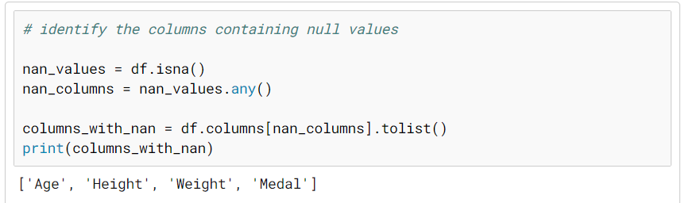
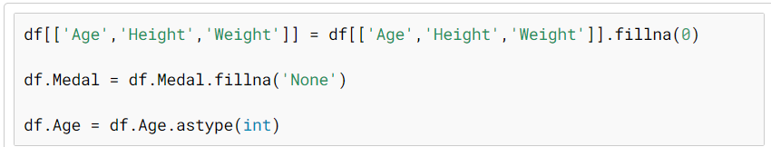
Data Preparation & Cleaning
As Age, height, weight are numerical columns. Replacing those values by zero. For Medal I will replace the NaN values by None Also converting the Age fielding to integer
BY – ASHISH SRIVASTAVA

Slide 6
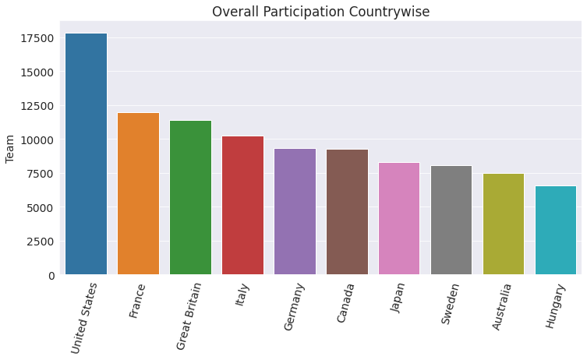
Exploratory Analysis and Visualization
Before we ask questions on the Olympic datasets, it would help to understand the participants ‘ demographics, i.e., country, age, gender etc. It’s essential to explore these variables to understand how representative the participants is of the worldwide sports community.
Top countries participating in Olympics
As USA has historically won maximum no of medals it would make sense the participation is highest from US. Surprisingly Soviet Union is not present in the list of top 10 countries.
BY – ASHISH SRIVASTAVA

Slide 7
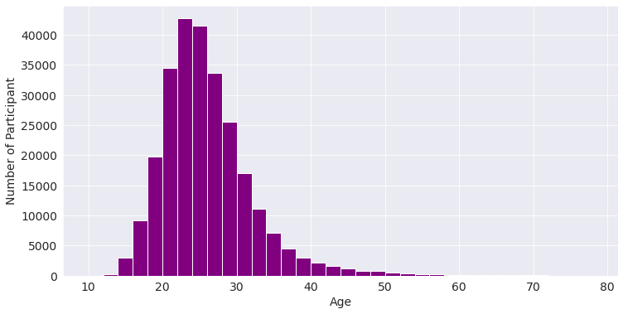
Age Distribution
From the above distribution we observe maximum participants are of age between 22–26 years, Which would make sense as it is likely for people with less age would perform better in active sport.
BY – ASHISH SRIVASTAVA

Slide 8
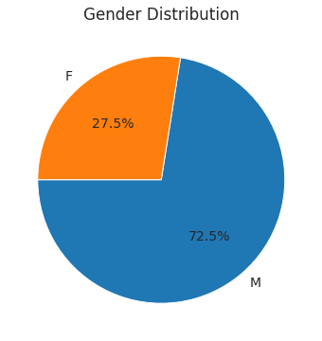
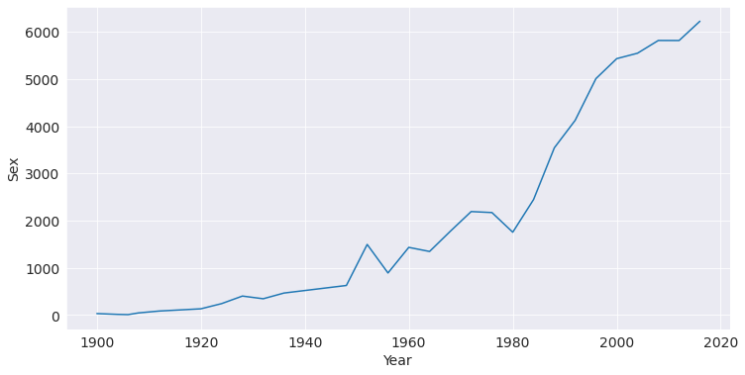
Gender Distribution
Although the female participation in 27.5% over the years it has increased significantly as displayed above
Male seems to be dominating in terms of participation. Let us check the female participants of the years 1900 to 2016
BY – ASHISH SRIVASTAVA

Slide 9

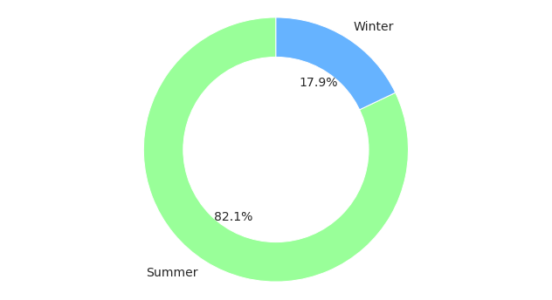
Participants Across Seasons
Winter Olympic has fewer participants than Summer Olympics because as per the data we have 52 sports and 651 events in summer Olympics where we have 17 sports and 119 events in winter Olympics.
Hence we have higher number of participants in summer Olympics
BY – ASHISH SRIVASTAVA

Slide 10
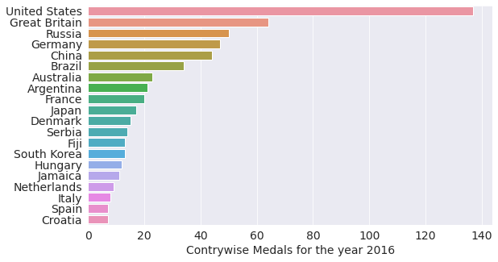
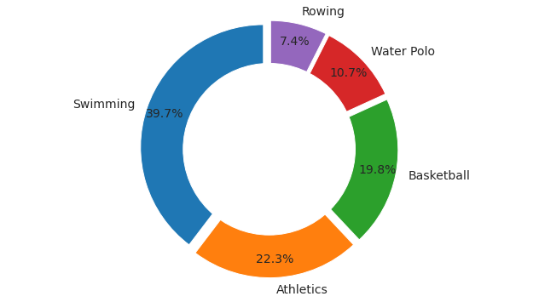
Q: Which countries WON the maximum Gold Medals in last held Olympic competitions?
US seems to lead the Gold medal charts for the last held Olympics in the year 2016.
Which sport fetch the most gold medals?
It seems like Swimming fetched the maximum Gold medals to US.
BY – ASHISH SRIVASTAVA

Slide 11
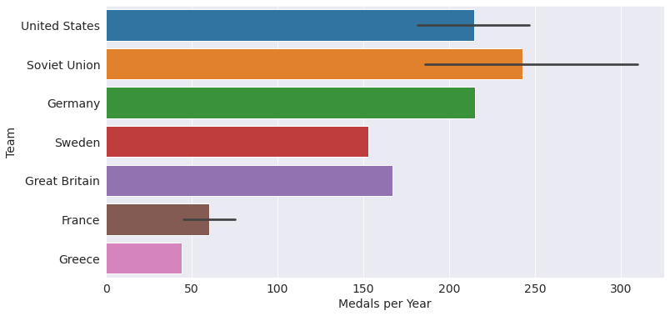
Q: Countries winning maximum Medals per year ?
Following are the insights we derive from above visuals
US seems to have been winning maximum medals for most number of years.
Soviet union seems to have Won highest number of medals in a Olympic event.
The winning variance in maximum with soviet union
Germany, Sweden, Great Britain and Greece has won maximum medals once
BY – ASHISH SRIVASTAVA

Slide 12
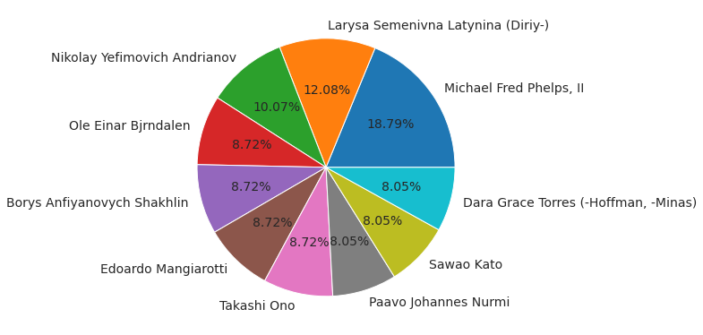
Q: Top 10 Individual winning maximum number of Olympics Medals for their country.
BY – ASHISH SRIVASTAVA

Slide 13
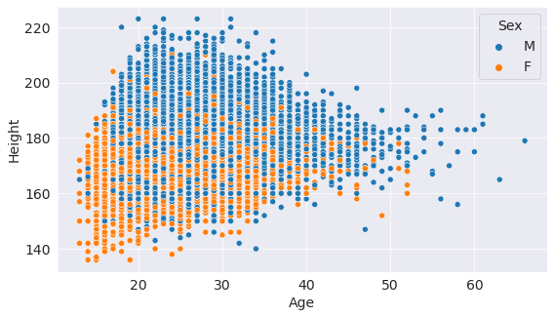
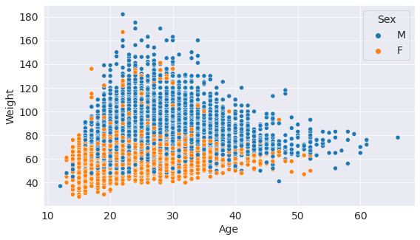
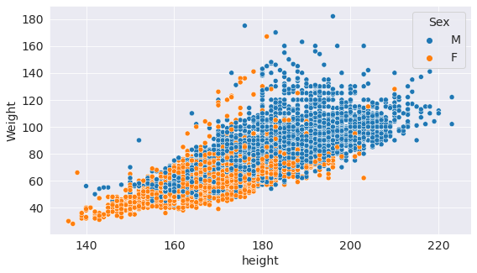
Q: Spread of Medal based on Age, Height and Weight
AGE & HEIGHT
An interesting observation is sportsman's with height less than 140 and age less than 20 are also winning Medals at Olympics.
AGE & WEIGHT
An interesting observation is sportsman's with weight more than 140 and age between 20 and 30 are also winning Medals at Olympics.
HEIGHT & WEIGHT
An interesting observation is sportsman's with weight less than 40 and height less than 150 are also winning Medals at Olympics.
BY – ASHISH SRIVASTAVA

Slide 14
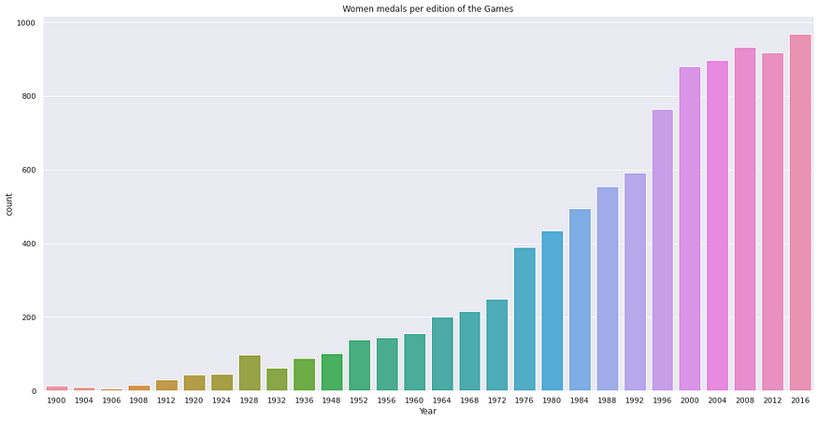
Q: Women participation at Olympics
As we see the trend, Woman participation has been increasing over the years on an average.
BY – ASHISH SRIVASTAVA

Slide 15
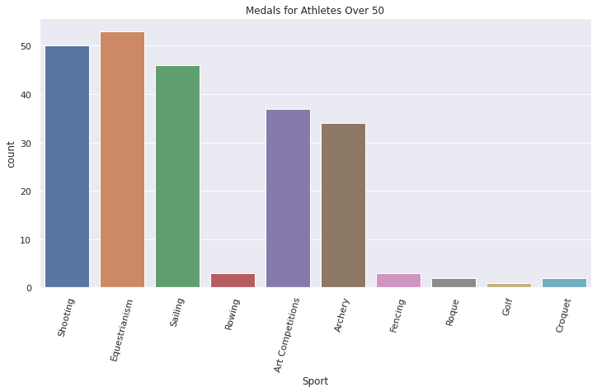
Q: Medal won Individual with Age more than 50
Individuals above 50 have been doing in Equestrianism, Shooting, Sailing, Art competitions and Archery. These sports seems to have require more mental strength and then physical strength.
BY – ASHISH SRIVASTAVA

Slide 16
Inferences and Conclusions
We’ve drawn many inferences from the survey. Here’s a summary of a few of them:
US seems to dominants in terms of participation of maximum gold as well as overall participation in games.
We observe athletes from the age of 12 till the age of 58 years winning medals.
Summer Olympics have higher no of events and sports as compared to the winter Olympics.
In the history of 120 years of Olympics, Michael Fred Phelps, II has won maximum medals for his country i.e. 28 Medals.
We see a trend that woman participants across the years in in upward tread.
Participate with high weight (like > 150) seems to have done well in Wrestling, Weight lifting and Judo.
BY – ASHISH SRIVASTAVA

Slide 17
THE END
Project By – Ashish Kumar Srivastava
Email – ashishsrivastav1999@gmail.com
LinkedIn - www.linkedin.com/in/ashish-srivastava-22850a25a
Github - https://github.com/Ashish-kr-Srivastava
BY – ASHISH SRIVASTAVA

